Slide 1
PROJECT NAME
“E - LEARNING”
Mr. Shubham Dhere.
Mr. Sunniraj Salunkhe.
Mr. Akash Kamble
Mr. Kalpesh Kamble.
Mr. Deepak Alate.
Mr. Vivek Bachashankar.
Ms. Pooja Dhoke.
Ms. Pooja Kadam.

Slide 2

INTRODUCTION
What is E-Learning

Slide 3

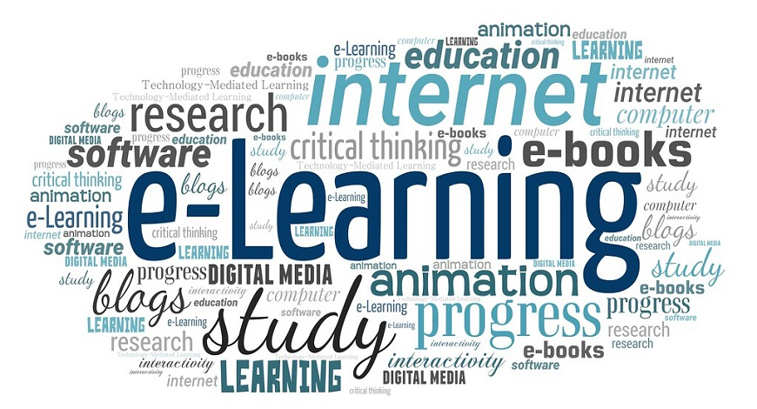

Slide 4
Flow Chart -
Logged In
Register
Student/
Admin
Course
Login
Select Course
Username
Password
Course
Assessment
Valid User
Exam
No
Certification
Login
Failed
End Exam

Slide 5
Advantages:
It is a very efficient way of delivering courses online.
Due to its convenience and flexibility, the resources are available from anywhere and at any time.
Web-based learning promotes active and independent learning.
As you have access to the net 24x7, you can train yourself anytime and from anywhere also.
Disadvantages:
Most of the online assessments are limited to questions that are only objective in nature.
There is also the problem of the extent of security of online learning programs.
The authenticity of a particular student's work is also a problem as online just about anyone can do a project rather than the actual student itself.
The assessments that are computer marked generally have a tendency of being only knowledge-based and not necessarily practicality-based.

Slide 6
THANK YOU.

